Slide 1
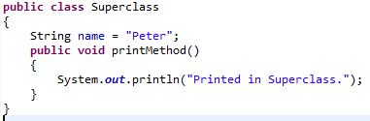
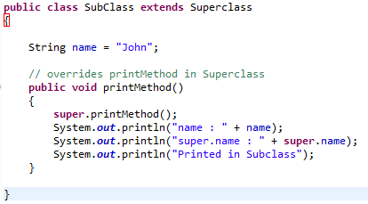
Accessing Superclass Members using super keyword
We can also use super to refer to a hidden field (although hiding fields is discouraged).
If your method overrides one of its superclass's methods, we can invoke the overridden method through the use of the keyword super.

